Slide 1
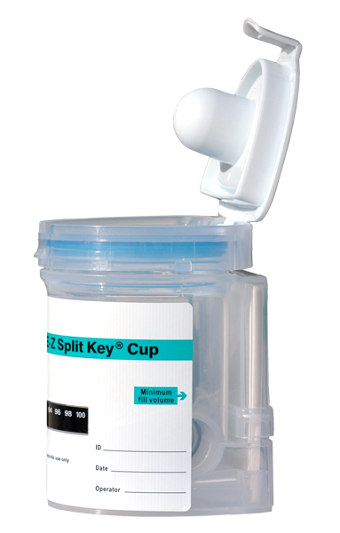
EZ-Cup Drug Screen
Training Program
Version 3.06
The EZ-Cup Drug Screen is only a preliminary screen and all positive screens must be confirmed using a more definitive form of testing such as GC/MS (Gas Chromatography/Mass Spectrometry) Confirmation programs are available upon request.
Use Page-up and Page-down to scroll through the slide show

Slide 2
EZ-Cup Drug Screen
Section One

Slide 3
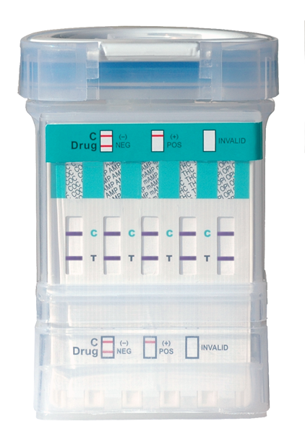
The
EZ-Cup
Large opening for easy
specimen collection
Completely closed system
for total urine specimen
integrity
Detects for up to 10 drugs
in the Test Window
Easily interpreted results
Clear construction for optimum
observation of urine specimen

Slide 4
The
EZ-Cup
Detects for up to 10 drugs
DRUG NAME
Phencyclidine
Amphetamines
Marijuana
Cocaine
Opiates (Morphine)
Methamphetamine
Benzodiazepines
Barbiturates
Methadone
Ecstasy
DRUG CODE
PCP
AMP
THC
COC
OPI
mAMP
BZO
BAR
MTD
MDMA
CUT OFF
25 ng/mL
1000 ng/mL
50 ng/mL
300 ng/mL
2000 ng/mL
1000 ng/mL
300 ng/mL
300 ng/mL
300 ng/mL
500 ng/mL
Available in 3 to 10 drug test configurations.
Various configurations detect for different drug combinations.
Consult your sales representative for exact configurations.

Slide 5
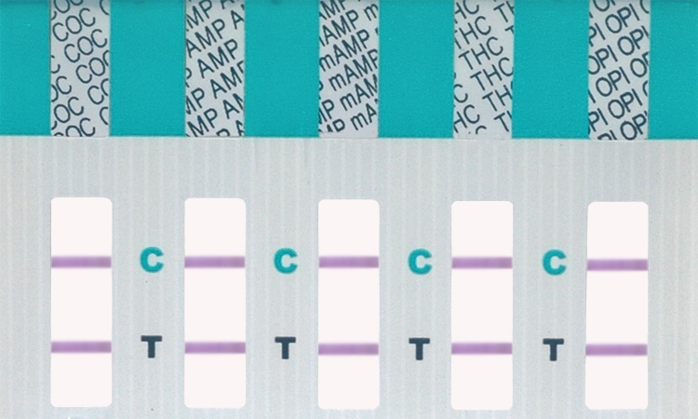
The
EZ-Cup
The Result Windows
The result window is located on the front side of the EZ-Cup.
When the test has run, the result window will display lines
indicating a positive, a negative, or an invalid result.
The results window is flat for easy photocopying.

Slide 6
The
EZ-Cup
EZ-Cup Drug Screen
Proper Procedure
Section Two

Slide 7
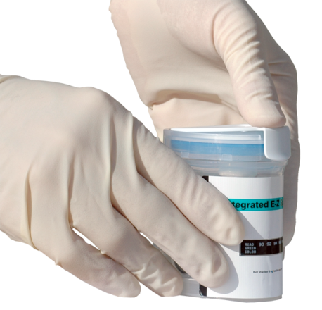
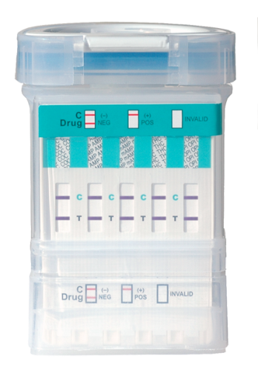
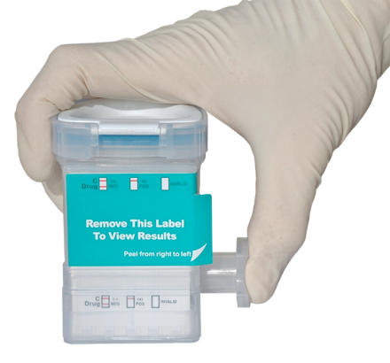
Overview of the Instructions
STEP 1 Have the donor provide a specimen (Collector retains the key)
STEP 2 Verify temperature is within range on the temperature strip. (90 –100°F)
Temperature Strip
STEP 3 Push the lid down until it snaps.
STEP 4 Push plunger into the side of cup firmly. This will activate cup.
STEP 5 Peel back the label to read the results

Slide 8
The
Instructions
STEP 1
Have donor provide specimen
Instruct the donor to
provide a urine specimen in the collection container and return it with the lid securely closed.
Note: Donor should provide specimen at least to the top of the temperature strip.

Slide 9
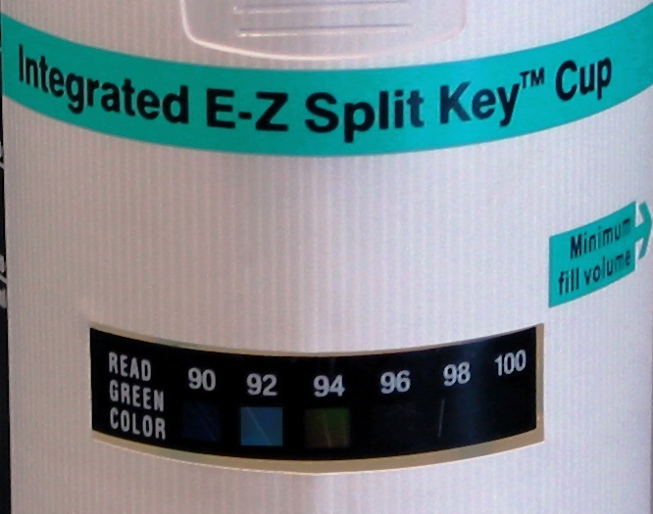
STEP 2
Inspect the Specimen
The
Instructions
While the donor is holding the collection container, inspect the specimen for color, consistency, temperature, and volume.
Note: The specimen temperature should be between 90-100 degrees F.

Slide 10
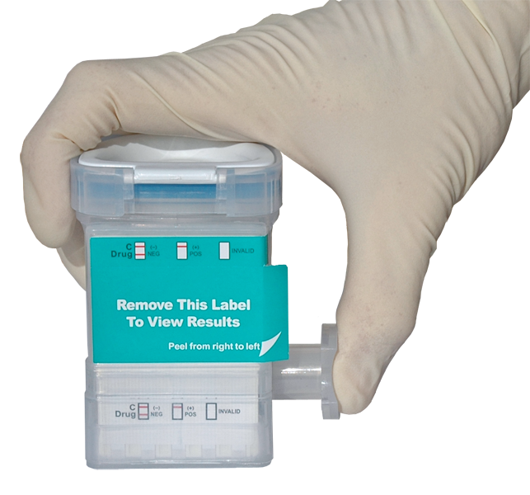
STEP 3 Initiate the test
The
Instructions
Once the specimen has been inspected for validity, remove the label to reveal the result window. Depress the activation key to activate the screen.
Never accept an open collection container from the donor. Always instruct the donor to secure the collection container lid prior to giving it to the collector.

Slide 11
The
Instructions
STEP 4 Read the Test Results
Lines will begin to develop in less than 30 seconds. Once the “C” control lines have clearly developed, negative results can be read. “Non-negative” results should be read at 5 minutes.
Note: The intensity of the line should not be considered when reading the results. Any visible line indicates a negative.

Slide 12
EZ-Cup Drug Screen
Interpreting The Results
Section Three

Slide 13
The
Interpretation
Reading the Result
Windows
Control Lines
Control lines are lines that appear in the test windows next to the letter “C” and indicate that the test has run and functioned properly.
Test lines are lines that appear in the test windows next to the drug abbreviations indicating the presence or absence of drug metabolite.
Note: If a test line appears, that is an indication of a “negative” specimen. Only the absence of a line (missing line) indicates a “positive” specimen.
Test Lines

Slide 14
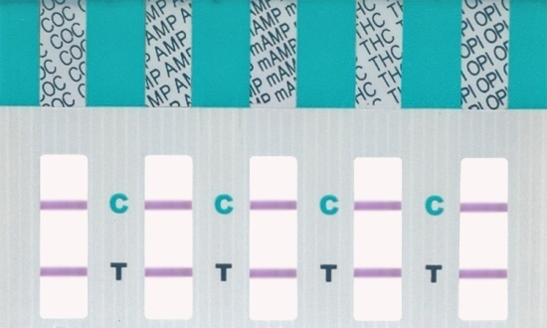
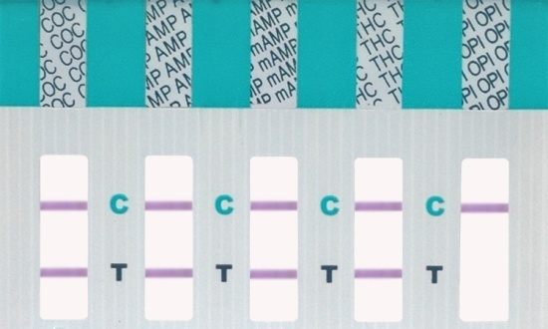
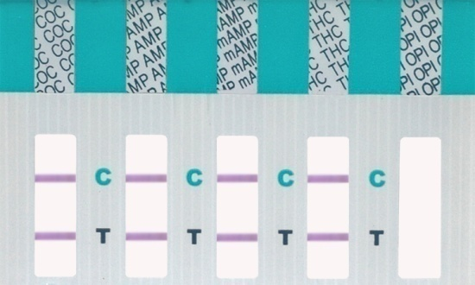
The
Interpretation
Reading the Result
Windows
“Negative” for all drugs.
Notice both control lines and test lines are present.
Any Test line – no matter how faint – is a negative result.
“Positive” for OPI (Opiates).
Notice test line on the OPI strip is missing. A missing line indicates a positive as long as a control line is visible.
“Invalid” Test.
Notice the missing control line in the last window. Any test with missing control lines must be considered invalid.

Slide 15
Questions
The next section is a series of questions. Go through the questions carefully and write your answers on the answer sheet provided. Then when you are finished, fax the answer sheet to us at 866-229-0722.

Slide 16
Question #1
A
B
C
D
E
Which drug class does each of the above letters represent?

Slide 17
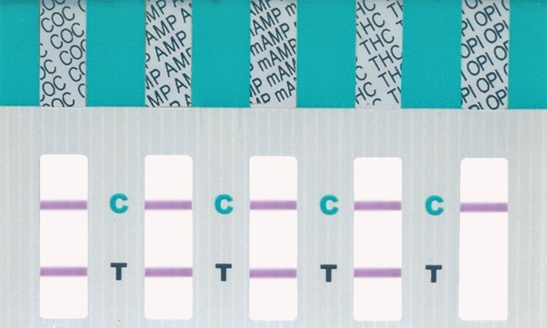
Question #2
A B C
2A. Which result window is “Positive?”
2B. Which result window is “Negative?”

Slide 18
Question #3
What is the correct outcome of this drug screen?

Slide 19
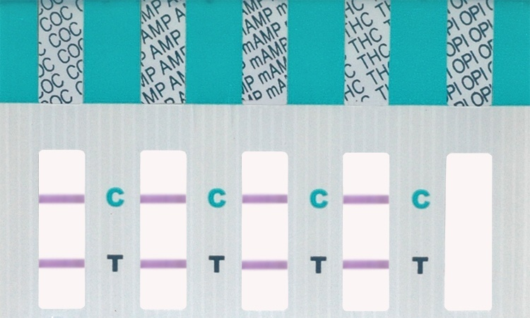
Question #4
What is the correct outcome of this drug screen?

Slide 20
Question #5
What is the correct outcome of this drug screen?

Slide 21
Completed
Congratulations! You have completed the EZ-Cup Training Program. We hope you have learned the proper use of EZ-Cup Drug Screen and are now ready to perform on-site, instant drug screens.
You may print the answer sheet provided on this CD presentation, fill in the answers and fax to
866-229-0722.

Slide 22
EZ-Cup Drug Screen Answer Sheet
Please fill in or circle the appropriate answer and fax answer sheet to 1-866-229-0722.
Please contact us if you have any questions concerning GC/MS confirmation.
Name:
Company:
Address:
City: St: Zip:
Phone:
1. What drug does each
letter represent?
2A. Which test
window has a
positive result?
A
B
C
2B. Which test
window has a
negative result?
A
B
C
A- ________________
B- ________________
C- ________________
D- ________________
E- ________________
3. What is the correct
outcome of this drug
screen?
A – Negative
B – Positive
C – Invalid
4. What is the correct
outcome of this drug
screen?
A – Negative
B – Positive
C – Invalid
5. What is the correct
outcome of this drug
screen?
A – Negative
B – Positive
C – Invalid
Hinged Lid Cup

